Slide 1
Data Science Using Python
Hye Young Kim

Slide 2
What Does “Data Science” mean?
(1) Collecting large amounts of data (Big Data)
Via computers, sensors, people, events …
(2) Doing something (Useful) with it
Making decisions, confirming hypotheses,
gaining insights, predicting future …
More specifically,
Data Science = Going from (1) to (2)
Data Science is Here to Stay
Ability to collect data will only increase
Ability to analyze data will only improve

Slide 3
How Big is the Data?
Complete works of William Shakespeare
5 megabytes
USA Library of Congress
10 terabytes (2 million Shakespeares)
Uploaded to Facebook daily
1 petabyte (200 million Shakespeares)
Produced by humanity daily (Now)
2.5 exabytes (500 trillion Shakespeares)

Slide 4
Applications of “Data Science”: Traffic

Slide 5
Applications of “Data Science”: Recommender System

Slide 6
And Many More
Weather prediction
Medical diagnosis
Financial markets
Resource management
Computational social science
Smart buildings and cities
The list goes on and on and it’s still early days.

Slide 7
Data Science Tools and Techniques
Basic Data Manipulation and Analysis
Performing well-defined computations or
asking well-defined questions (“queries”)
Data Mining
Looking for patterns in data
Machine Learning
Using data to make inferences or predictions
Data Visualization
Graphical depiction of data
Data Collection and Preparation

Slide 8
Data Visualization
A picture is worth a thousand words
A picture is worth trillion data points

Slide 9
Basic Data Visualizations

Slide 10
Advanced Data Visualizations

Slide 11
Languages, Systems, Platforms
Spreadsheets
Surprisingly versatile and powerful for data analysis tasks, but not truly big data
Programming languages with big-data support
R Language – powerful statistical features
Python – general-purpose language with R-like add-ons (Pandas, SciPy, scikit-learn)
Data processing in the cloud
Amazon Web Services, Google Cloud, Microsoft Azure

Slide 12
Why do you care?

Slide 13

Python
Python is an open-source, general-purpose scripting language.
Open-source
Built by a community
Maintained by a community
Free to use for all
General Purpose
If you’re doing it on a computer and there’s some repetitive element, then you can automate it in Python.
Python isn’t limited to Data Science, but it’s very popular with data scientists!
Scripting
Series of commands to automate some task.
Like a pipeline: takes some inputs, does some things to these inputs, and gives back some outputs.
It’s good to keep the input-output framework in your head.
Python natalensis by A. Smith on Wikimedia Commons
Notes:
Started by Guido Van Rossum as a hobby over the Christmas vacation.
- named after Monty Python's Flying Circus
- First released in 1991, loved by Unix scripters
- Now transformed into the most popular interpreted language. You can build anything with it!
- Facts! Python was the most used language in 2016 and still most likely is!

Slide 14
Python (Cont.)
Scripting
Series of commands to automate some task.
Like a pipeline: takes some inputs, does some things to these inputs, and gives back some outputs.
It’s good to keep the input-output framework in your head.
Language
Python is a language, and not an application.
Practical difference for you:
most applications provide you options to select from.
languages require to generate commands from accepted rules.
Bottom line is that you can do nearly anything with Python!

Slide 15
What Can I use Python For?
Clean up my messy data!
Run analyses with (hundreds of) millions of data points it won’t fit into an excel spreadsheet!
I want to automate downloading several decades of newspaper articles!
I want to create beautiful (interactive) visuals to accompany my analyses!
I want to uncover hidden structures linking parliamentary committees!
I want to track the changing meaning of a concept over a century!
Again: any repetitive task done on a computer can be automated with Python.

Slide 16
Tools of the Trade
Anaconda
Environment and software manager.
Can be used from the command line (cli) or browser-like interface (anaconda-navigator).
Notes:
Make sure students can find navigator, and open applications
from it.

Slide 17
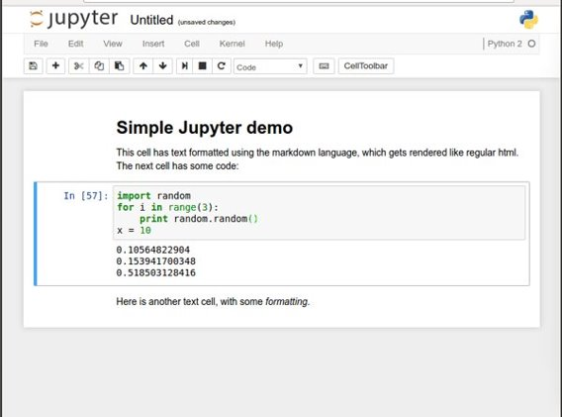
Tools of the Trade
Jupyter Notebook
Interactive code editor.
Easy to use environment
Web-based
Combines both text and code into one

Slide 18
Basic Workflow
Open up Anaconda Navigator
Open up Jupyter Notebook
Navigate to relevant directory
Open pre-existing notebook, or create new one.
Start coding

